Slide 1


Music Recommendation Challenge
DS 4559 Final Project
Charlie Tolleson and George Wilson

Slide 2
“Can you build the best music recommendation system?”
Concept of Operations
Introduction
Methods
Redesign Goals
User Groups
Results
Event History
Conclusions
Unlimited Streaming Services replace Radio DJs
Personalized Recommendation Algorithms needed
KKBOX - Asia’s Largest Streaming Service
30 million+ songs
Classification Problem:
Target = 1 means recurring listening event(s)
within one month after first listen
Target = 0 no recurring listening events within one month
Basic equivalent to “Recommend”

Slide 3
That’s a lot of data...
Concept of Operations
Introduction
Methods
Redesign Goals
User Groups
Results
Event History
Conclusions
Train Dataset
7+ million rows
User_id, song_id
source_system_tab
source_screen_name (layout)
source_type (entry point)
Target feature (1, 0)
Members
registration/expiration time
city, gender, age
Test Dataset
2+ million rows
Same as train, no target feature
Songs Dataset
Song_id, song_length (ms)
Genre_id, artist_name
Composer, Lyricist
Language
Song extra info dataset
Song_id, Song_name
ISRC

Slide 4
Merging and Cleaning Data
Concept of Operations
Introduction
Methods
Redesign Goals
User Groups
Results
Event History
Conclusions
Merge all datasets to create one single train, test
Removed NA’s from train set
Miniscule amount affected in whole
Imputed NA’s in testing set
Needed entire set
Median imputation

Slide 5
Feature Engineering
Concept of Operations
Introduction
Methods
Redesign Goals
User Groups
Results
Event History
Conclusions
Registration/Expiration year, month, day
Extracted from Registration Date, Expiration Date
Song Year
Extracted from IRSC “extra_song_info” data
Count of Song Played
Extracted # times a song has been played from test/train
Count of Artist Played
Featured
1 if artist contained “feat”

Slide 6
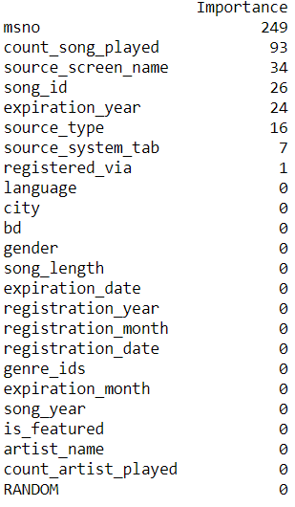
Feature Engineering
Concept of Operations
Introduction
Methods
Redesign Goals
User Groups
Results
Event History
Conclusions
Notes:
Based on light gradient boosting model

Slide 7
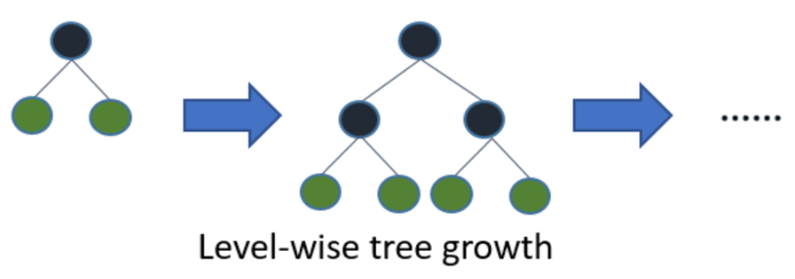
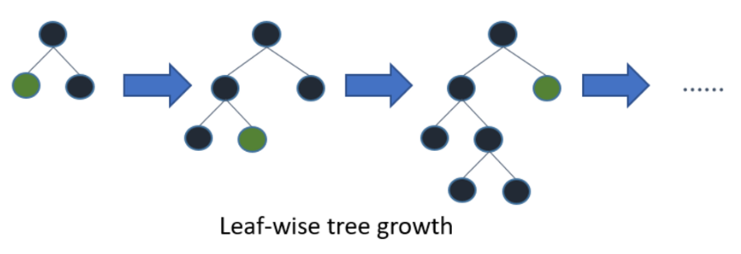
Model Selection
Concept of Operations
Introduction
Methods
Redesign Goals
User Groups
Results
Event History
Conclusions
Random Forests
Boosting
Exploring LightGBM
High speed
Best with large data
Traditional Boosting Algorithms
Light GBM

Slide 8
Summary of Results: Problems
Concept of Operations
Introduction
Methods
Redesign Goals
User Groups
Results
Event History
Conclusions
Categorical data difficult to deal with
Label encoding vs One-hot encoding
Can’t see performance on actual test set
Limit 5 submissions per day
AUC calculations returned
AUC perform worse than on mini test sets from training data
0.80 AUC on subset of given data → < 0.67 on actual
Computational times

Slide 9
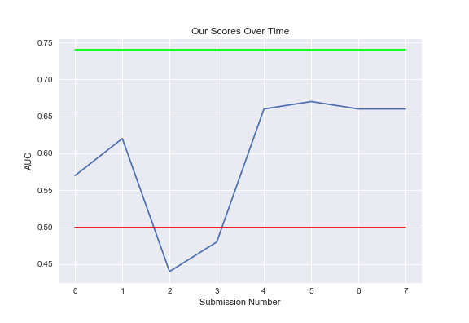
Summary of Results: Performance
Concept of Operations
Introduction
Methods
Redesign Goals
User Groups
Results
Event History
Conclusions
AUC Score Progression (on test data)

Slide 10

Summary of Results
Concept of Operations
Introduction
Methods
Redesign Goals
User Groups
Results
Event History
Conclusions
Kaggle Competitions are hard
Everyone uses XGBoost, Light GBM
Despite not understanding it as well
SO MUCH DATA
Position 343 out of 981

Slide 11
Conclusion + Recommendations
Concept of Operations
Introduction
Methods
Redesign Goals
User Groups
Results
Event History
Conclusions
Engineer more meaningful features
Remove highly correlated variables
Grid search/optimization LGBM parameters
Requires better understanding of model
Future investigations: Language
Each have different norms→ we should dig deeper
Note: Language data is anonymized (random number)

Slide 12
THANK YOU

